Slide 1

Sentiment Analysis CS677 SC1 Data Science with Python
Jyoti Sharma

Slide 2
Agenda
Project Goal
Dataset Overview
Classifiers overview
Classification process
Results
Conclusion

Slide 3
Project Goal
The goal of this project is to extract the sentiments from tweets.
Classification is done in two categories positive or negative.
From a tweet text we are trying to understand if the person is trying to convey a positive message or negative message.

Slide 4
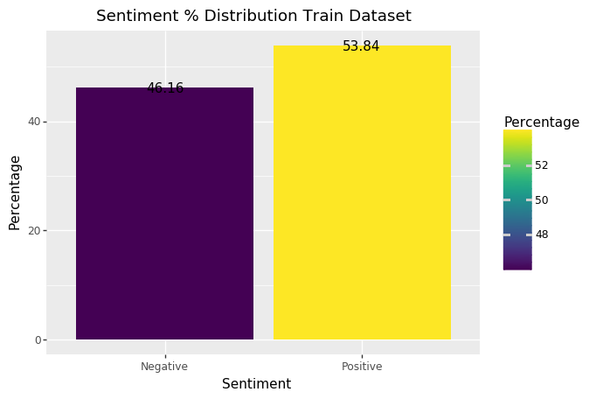
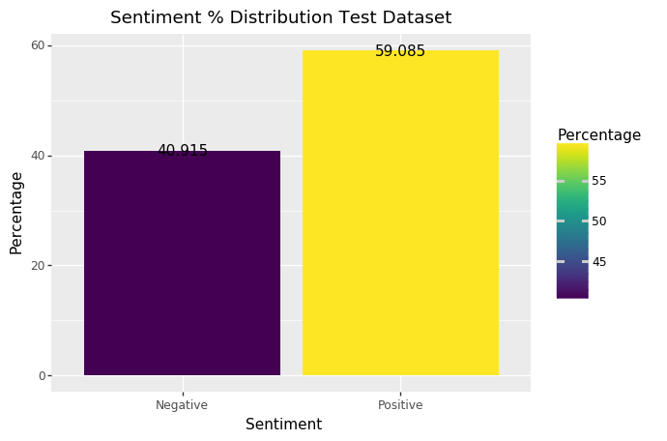
Dataset Overview
Dataset is split into two parts – Train and Test
Train consists of ﻿49983 tweets (﻿26911 Positive and 23072 negative)
Test consists of ﻿50006 tweets (﻿29546 Positive and 20460 negative)

Slide 5
Classifiers overview
For classification we have used SklearnClassifier coupled with nltk.
List of classifiers used :
1.) MultinomialNB
2.) Logistic Regression
3.) SGD
4.) AdaBoost Classifier with ﻿LinearSVC
5.) AdaBoost Classifier with ﻿LogisticRegression
6.) Voted Classifier (Combination of all)

Slide 6
Classification Process
Dataset cleaning
Split Dataset into Train and Test
Training classifiers
Document creation (set of tweet text and sentiments)
Generate list of frequently used words
Create Feature set (tuple of set of frequent words and sentiments)
Train the classifiers
Save the classifier
Test the data for accuracies
Load saved classifiers
Classify each record using all classifier
Using voted classifier predict the sentiment (every classifier vote has equal weightage)

Slide 7
Results
In order to understand the impact of feature set on classification process two feature sets were created and tested
Feature set 1: Allowed verbs , adjectives and Nouns.
Feature set 2: Allowed verbs and adjectives only.

Slide 8
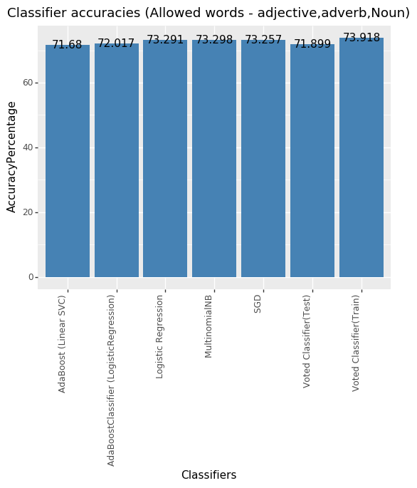
Results (using Feature set 1)

Slide 9
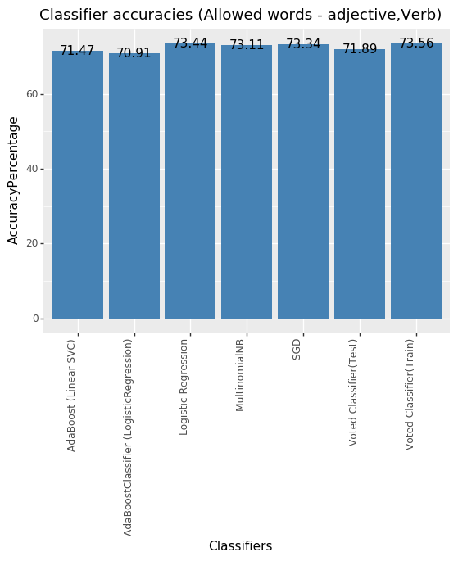
Results (using Feature set 2)

Slide 10
Conclusion
Creating different feature sets did not contribute in accuracy % improvement .
The accuracy of of Voted classifier for Test data set is same for both feature sets ~71.89%

Slide 11

Q&A

